Slide 1


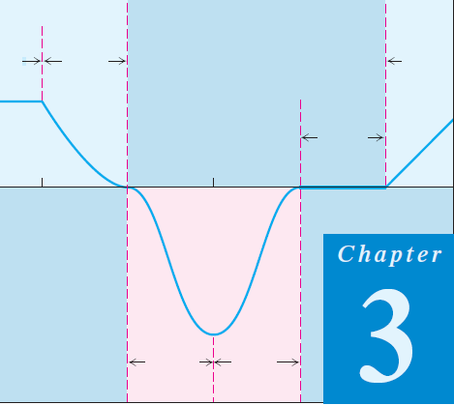
Thomas Calculus 11th
04
Differentiation
Samuel Lukas

Slide 2
Agenda
Basic Principle differentiation
Rules of Differentiation
Chain rule and parametric differentiation
Implisit differentiation and
Higher order differentiation

Slide 3
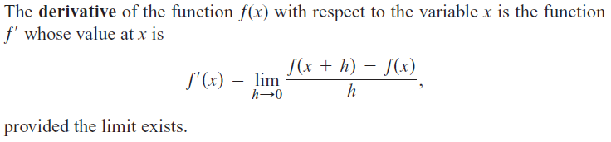

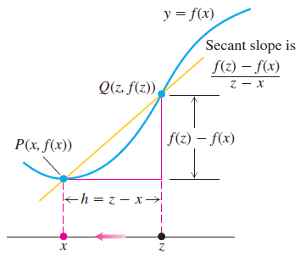



Basic Principle
Prove :

Slide 4
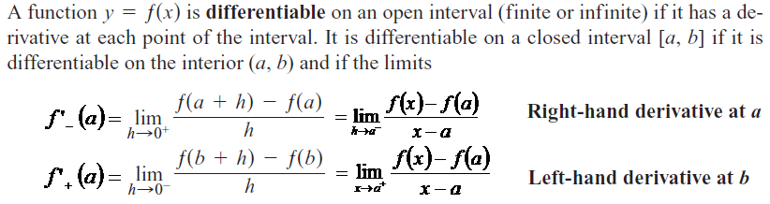
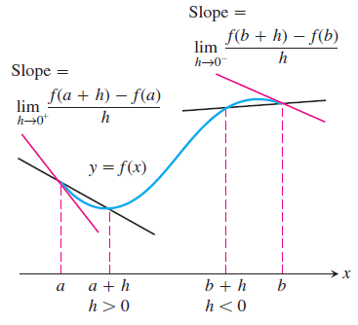
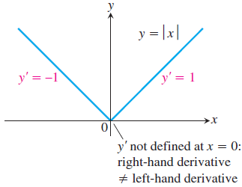


One-Sided Derivatives

Slide 5
Example 1

Slide 6

Derivative at a Point
Iff
Not exist
Is continuous at x = 0 but
is not exist

Slide 7
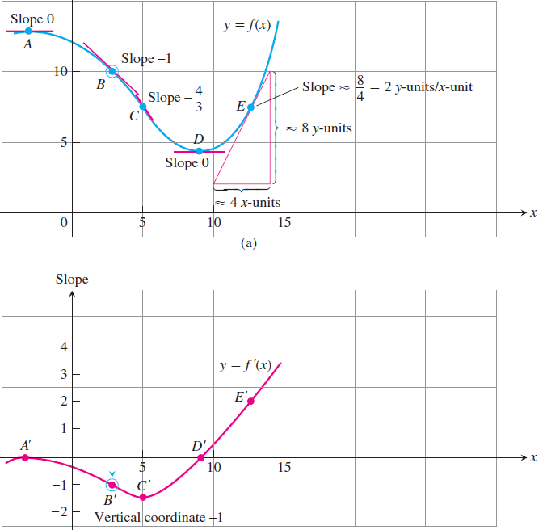
The meaning of Differentiation
Differentiation of f(x) at x = a is a tangen line slope of f(x) at x = a

Slide 8



Example 2
Find an equation of the tangent line at the indicated point on the graph of the function.
The tangent line at the indicated point of the function is

Slide 9

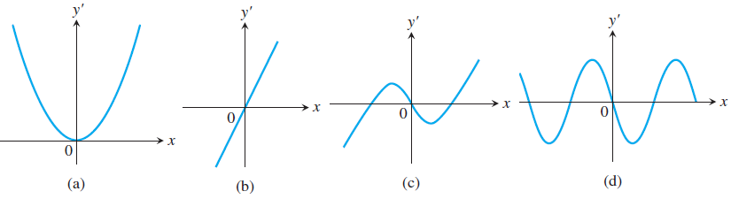
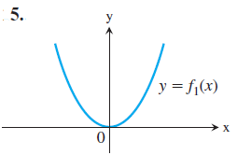
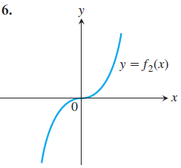
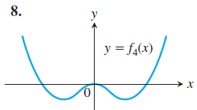
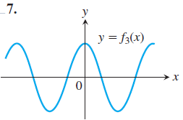
Exercise 1
Differentiate the functions and find the slope of the tangent line at the given value of the independent variable.
Match the functions graphed in Exercises 5–8 with the derivatives graphed in the accompanying figures (a)–(d).

Slide 10
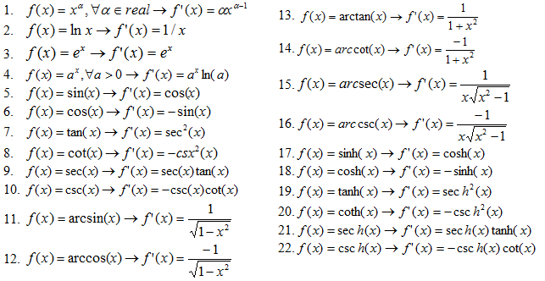
Differentiation of Basic Functions

Slide 11



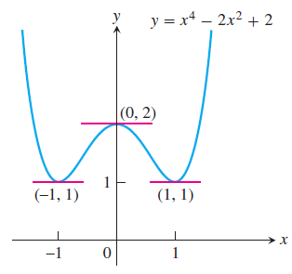








Differentiation Rules

Slide 12









Example 3

Slide 13
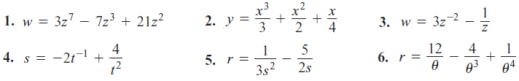
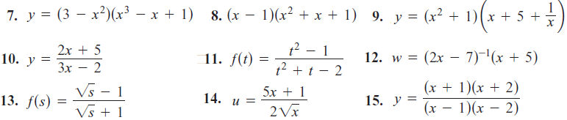

Exercise 2
Find the first and second derivatives.

Slide 14
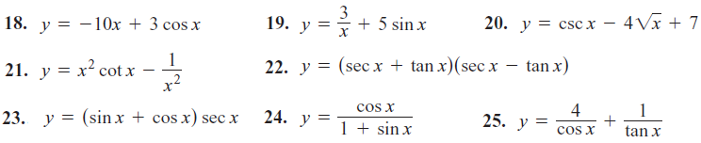




Slide 15
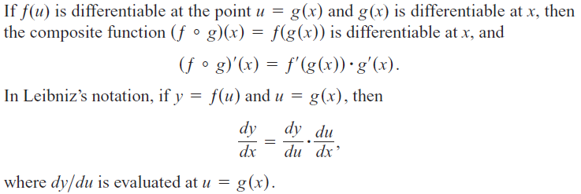
The Chain Rule

Slide 16




Example 4

Slide 17
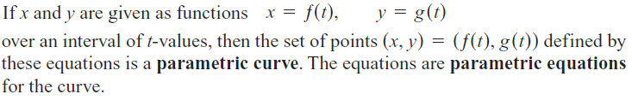
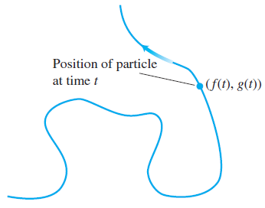



Parametric Curve

Slide 18



Example 5

Slide 19
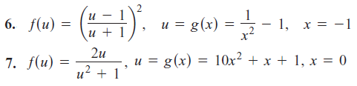
Exercise 3
Find the first and second derivatives.

Slide 20

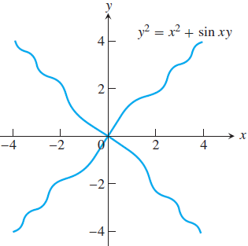







Implicit Differentiation

Slide 21
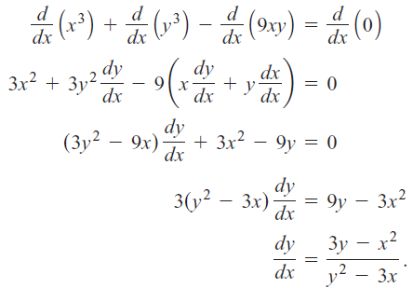
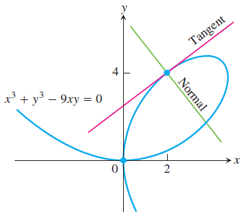

Example 6

Slide 22

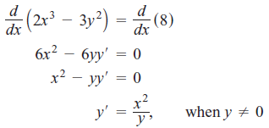


Derivatives of Higher Order

Slide 23



Exercise 4

